Slide 1

Ciamar a tha thu an-diugh?
Notes:
How are you today?

Slide 2

Ciamar a tha thu an-diugh?
Chan eil mi gu math.
Notes:
How are you today?
I’m not well.

Slide 3
Dè tha ceàrr ort?
Tha mo cheann goirt.
Notes:
What’s wrong with you?
My head is sore.

Slide 4
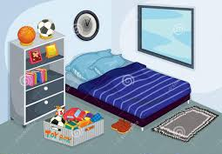
Obh, obh, laigh air do
leabaidh.
Notes:
Oh dear, lie on your bed.

Slide 5

Ciamar a tha thu an-diugh?
Chan eil mi gu math.
Notes:
How are you today?
I’m not well.

Slide 6
Dè tha ceàrr ort?
Tha mo stamag goirt.
Notes:
What’s wrong with you?
My tummy is sore.

Slide 7
Obh, obh, laigh air do
leabaidh.
Notes:
Oh dear, lie on your bed.

Slide 8

Ciamar a tha thu an-diugh?
Chan eil mi gu math.
Notes:
How are you today?
I’m not well.

Slide 9
Dè tha ceàrr ort?
Tha mo chasan goirt.
Notes:
What’s wrong with you?
My legs are sore.

Slide 10
Obh, obh, laigh air do
leabaidh.
Notes:
Oh dear, lie on your bed.

Slide 11
Ciamar a tha thu an-diugh?
Tha mi
gu math
an-diugh.
Notes:
How are you today?
I am well today.

Slide 12
Glè mhath, càirich do
leabaidh.
Notes:
Very good, make your bed.

